Slide 1

“State Feedback Controller for phase shifted full bridge DC-DC converter”
1
Presented by
Sarfaraj Ahmed (Roll No.231040069
Naveenkumar V(Roll No.190536)
Visvesh Subramani(Roll No.190984)
Aditi Arya(Roll No.190056)

Slide 2
2
INTRODUCTION
1.State space model
2.Objective of the controller
3.Design and justification of the state feedback controller
4.Design of the Luenberger observer
5.Justification of the performance of the observer
6.Conclusion/Future work:

Slide 3
What is Phase shifted DC-DC converter?
3
A phase-shifted DC-DC converter is a type of power electronic converter used to convert a DC (direct current) voltage from one level to another with the ability to control the output voltage
ZVS (Zero Voltage Switching) or ZCS (Zero Current Switching): Phase-shifted converters are designed to achieve soft-switching, where the voltage or current across the switching devices becomes zero before the device is turned on or off. This minimizes switching losses and improves overall efficiency.
Reduced Transformer Core Losses: By controlling the phase shift, the converter can reduce the core losses in the transformer, leading to improved efficiency.
Improved Thermal Performance: The soft-switching characteristics help in reducing the heat generated during the switching transitions, which is beneficial for the overall thermal performance of the converter.
Better Control of Output Voltage: The phase-shift control allows for precise control of the output voltage, making it suitable for applications where accurate voltage regulation is required.
Parallel Operation Capability: Phase-shifted converters can be operated in parallel to achieve higher power levels, providing scalability for different power requirements.
These converters are commonly used in various applications, including power supplies for electronic devices, renewable energy systems, electric vehicles, and other power electronics applications where efficient DC voltage conversion is essential.

Slide 4
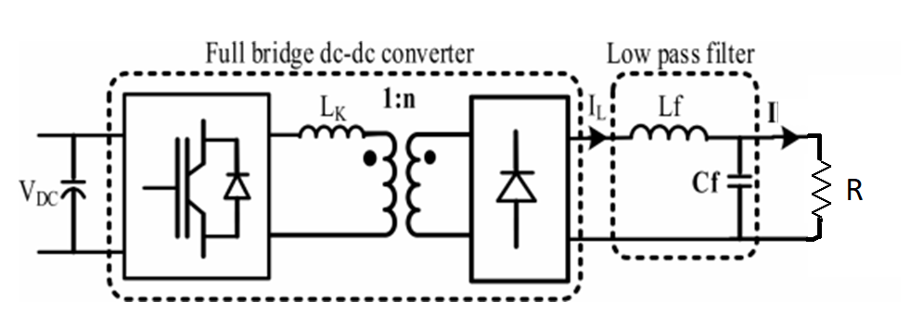
4
2.STATE SPACE MODEL
For phase shifted DC-DC converter with load

Slide 5
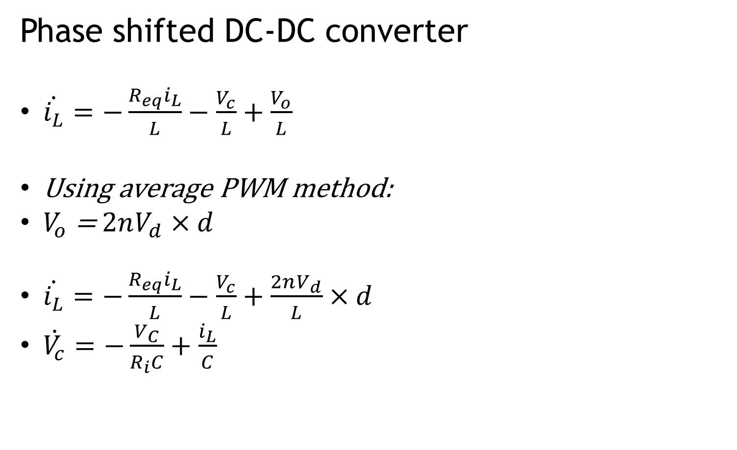
Phase shifted DC-DC converter
$\dot{i_{L}}=−\frac{R_{eq}i_{L}}{L}−\frac{V_{c}}{L}+\frac{V_{o}}{L}$
Using average PWM method:
$V_{o}$ = $2nV_{d}×d$
$\dot{i_{L}}=−\frac{R_{eq}i_{L}}{L}−\frac{V_{c}}{L}+\frac{2nV_{d}}{L}×d$
$\dot{V_{c}}=−\frac{V_{C}}{R_{i}C}+\frac{i_{L}}{C}$

Slide 6
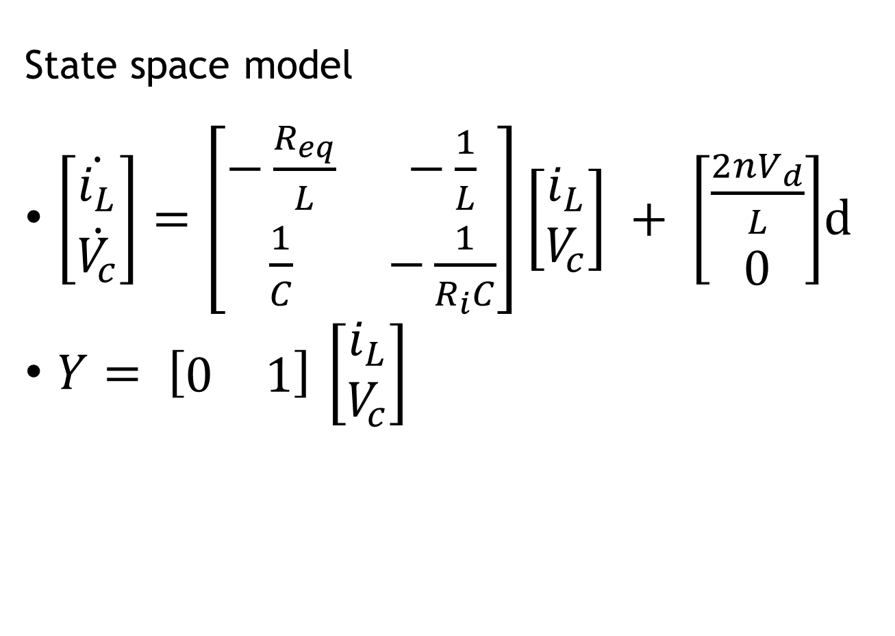
State space model
$\left[\begin{matrix}\dot{i_{L}} \\ \dot{V_{c}}\end{matrix}\right]=\left[\begin{matrix}−\frac{R_{eq}}{L} & −\frac{1}{L} \\ \frac{1}{C} & −\frac{1}{R_{i}C}\end{matrix}\right]\left[\begin{matrix}i_{L} \\ V_{c}\end{matrix}\right] + \left[\begin{matrix}\frac{2nV_{d}}{L} \\ 0\end{matrix}\right]$d
$Y= \left[\begin{matrix}0 & 1\end{matrix}\right]$ $\left[\begin{matrix}i_{L} \\ V_{c}\end{matrix}\right]$

Slide 7
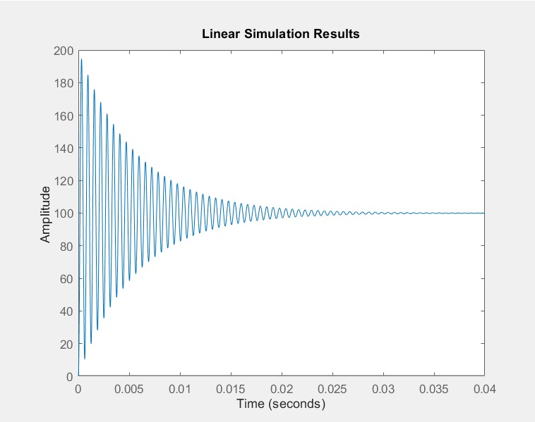
State space response for step input

Slide 8
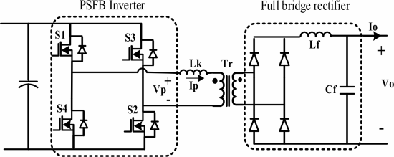
2.OBJECTIVE OF THE CONTROLLER
The controller must drive 4 MOSFETS such that we follow or track a desired output voltage. We do this by generating an AC-PWM
We achieve this by generating two phase shifted square wave signals that have a phase difference φ.
The first PWM is supplied to the first MOSFET S1 and its inverted output is connected to S4
The second PWM is supplied to the first MOSFET S2 and its inverted output is connected to S3
Objective of this controller is to reduce the overshoot and reduce settling time.

Slide 9
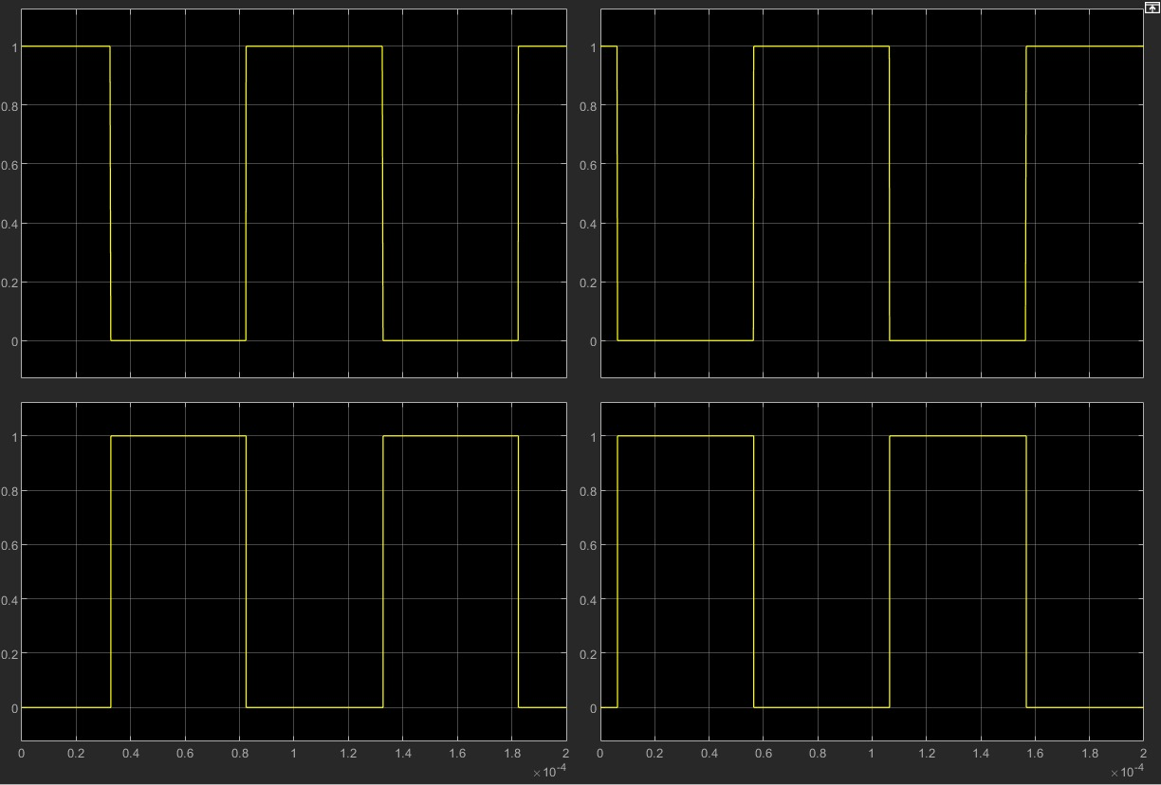
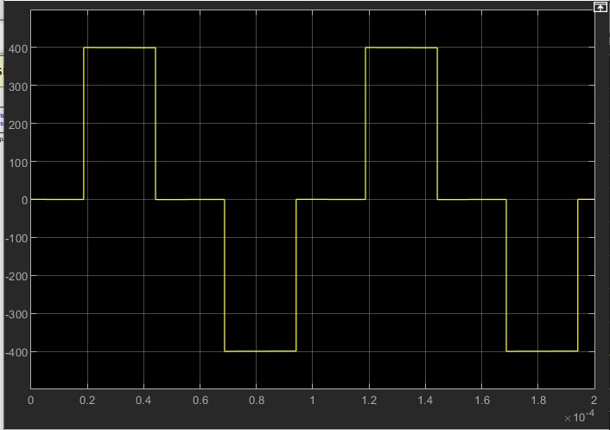
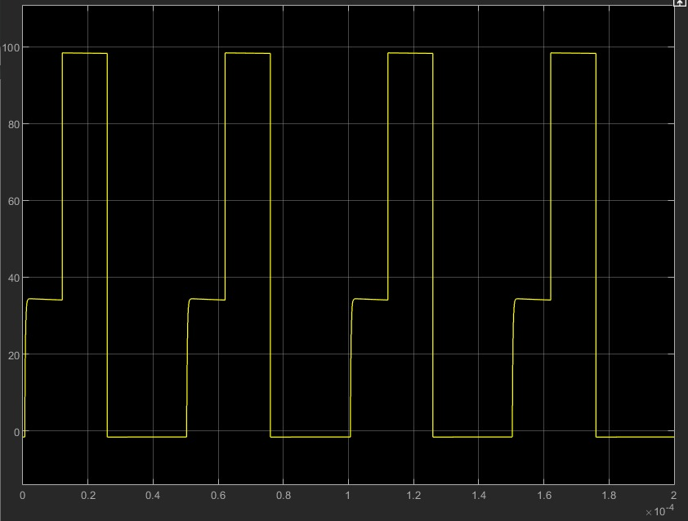
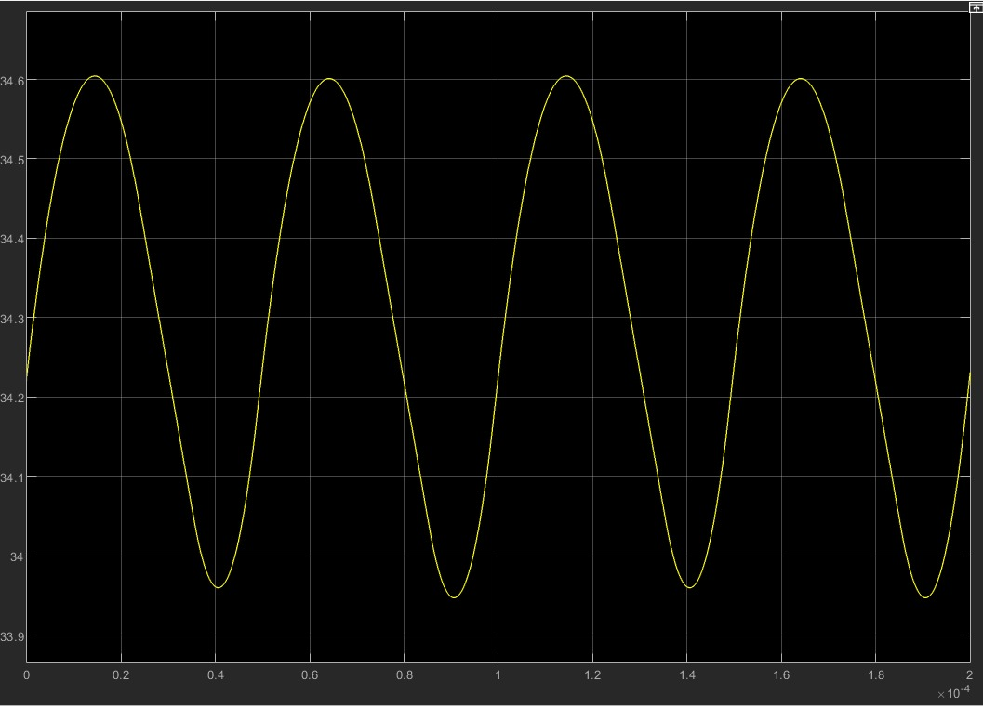
3.DESIGN AND JUSTIFICATION OF STATE FEEDBACK CONTROLLER
Input for MOSFET
(clockwise S1,S3,S2,S4)
b)Input for Transformer
c)Rectifier output
d)Output from LPF

Slide 10
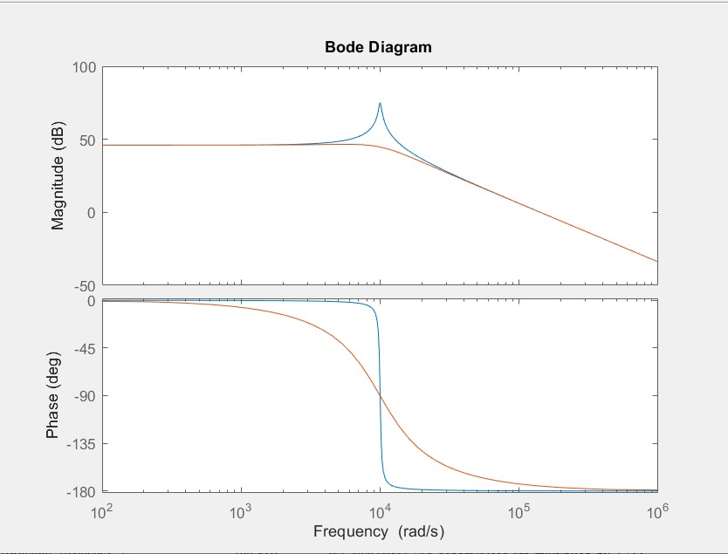
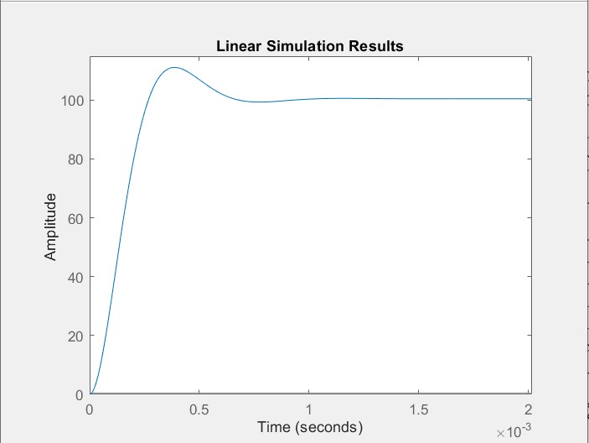
a) Initial bode plot
(blue-before pole placement)
(red-after pole placement)
b) Response after pole placement
Design constraints
1ms settling time
<10% peak offshoot
Gain = 1

Slide 11
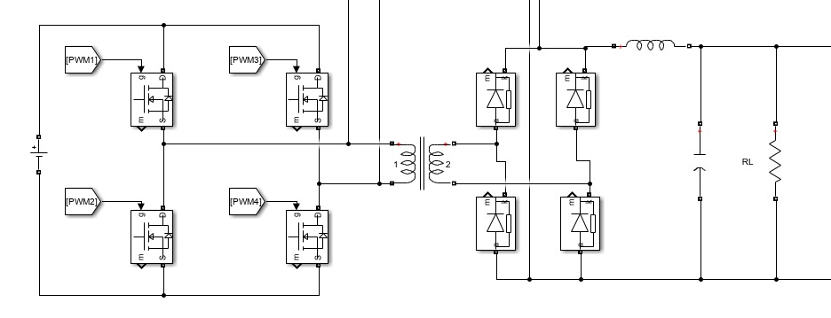
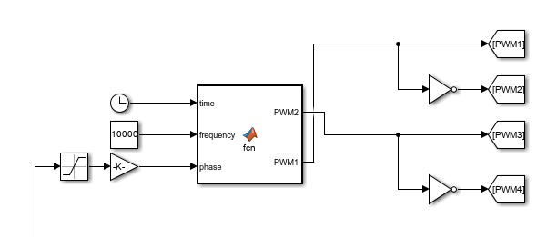
a)PSFB converter
b)PWM generator

Slide 12
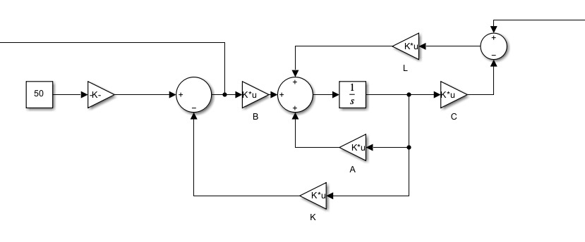
4.DESIGN OF LUENBERGER OBSERVER
Poles in this luenberger observer are selected converges 10x faster than the k matrix.

Slide 13
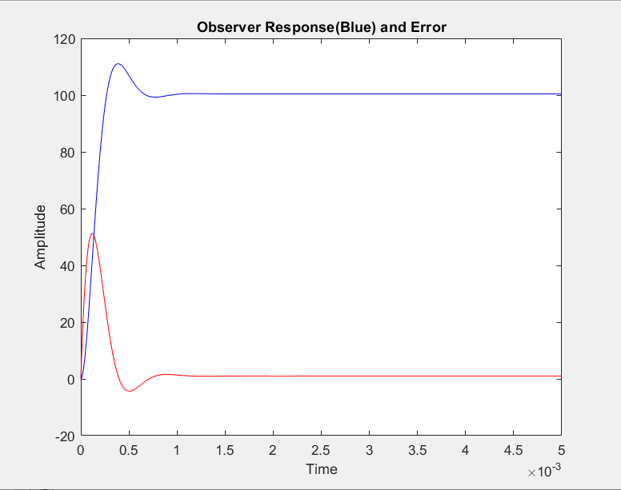
5.JUSTIFICATION OF THE PERFORMANCE OF THE OBSERVER
Luenberger response
We can see from this graph that the output converges to expected output and error converges to zero

Slide 14
INPUTS
INPUTS | VALUES
Load Resistance (R_i) | 100
Transformer Leakage Inductance(L_lk) | 5x10^-6
Switching frequency(F_s) | 20000
DC Input(V_d) | 400
LC Filter(L) | 10^-4
LC Filter Capacitance(C) | 10^-4
Resistor in series with LC Filter (R_eq) (Used to model duty cycle drop du to transformer leakage inductance) | 4*L_lk*f_s*n^2

Slide 15
MATLAB CODE FOR CONTROLLER DESIGN
clc;clear;close all;
R_i = 100;
R_ct = 0;
C_dl = 1;
V_oc = 0;
n = 1/4;
L_lk = 5e-6;
f_s = 20000;
V_d = 400;
L = 100e-6;
C = 100e-6;
R_eq = 4*L_lk*f_s*n^2;
d = 0.5;
A = [ -R_eq/L -1/L ;
1/C -1/(R_i*C);]
B=[2*n*V_d/L ; 0 ];
C=[0 1];
Co=ctrb(A,B)
rank(Co)
ob=obsv(A,C)
Ro=rank(ob)
t=0:0.00001:0.04;
u=d*ones(size(t));
sys_org = ss(A,B,C,0)
eig(sys_org)
tf(sys_org)
[y,t] = lsim(sys_org,u,t);
figure(1)
plot(t,y)
hold on
title("Original System Response Duty Cycle 0.5(Max duty cycle)")
xlabel("Time")
ylabel("Amplitude")
hold off;
K=place(A,B,11.6*[(-500+700i),(-500-700i)])
sys_mod = ss(A-B*K,B,C,0)
eig(sys_mod)
tf(sys_mod)
t1=0:0.00001:0.005;
u1 = d*ones(size(t1));
[y,t,x] = lsim(sys_mod,u1,t1);
figure(2)
plot(t,y)
hold on
title("System Response After Addition of Gains Matrix K Duty Cycle 0.5(Max duty cycle)")
xlabel("Time")
ylabel("Amplitude")
hold off;
figure(3)
hold on;
bode(sys_org)
bode(sys_mod)
hold off;
L=place(A',C',116*[(-500+700i),(-500-700i)])'
At=[A-B*K B*K;zeros(size(A)) A-L*C];
Bt=[B; zeros(size(B))];
Ct=[C zeros(size(C))];
sys_o=ss(At,Bt,Ct,0);
n=2;
[y,t1,x]=lsim(sys_o,u1,t1,[[0,0] [0,0]]);
e=x(:,n+1:end);
x=x(:,1:n);
xe=x-e;
x1=x(:,1);x2=x(:,2);
xe1=xe(:,1);xe2=xe(:,2);
figure(4)
plot(t1,x1,'-r',t1,xe1,'--r',t1,x2,'-b',t1,xe2,'--b')
hold on
title("Observer Response(Blue) and Error");
xlabel("Time");
ylabel("Amplitude");
hold off;

Slide 16
t1=0:0.00001:0.005;
u1 = d*ones(size(t1));
[y,t,x] = lsim(sys_mod,u1,t1);
figure(2)
plot(t,y)
hold on
title("System Response After Addition of Gains Matrix K Duty Cycle 0.5(Max duty cycle)")
xlabel("Time")
ylabel("Amplitude")
hold off;
figure(3)
hold on;
bode(sys_org)
bode(sys_mod)
hold off;
L=place(A',C',116*[(-500+700i),(-500-700i)])'
At=[A-B*K B*K;zeros(size(A)) A-L*C];
Bt=[B; zeros(size(B))];
Ct=[C zeros(size(C))];
sys_o=ss(At,Bt,Ct,0);
n=2;
[y,t1,x]=lsim(sys_o,u1,t1,[[0,0] [0,0]]);
e=x(:,n+1:end);
x=x(:,1:n);
xe=x-e;
x1=x(:,1);x2=x(:,2);
xe1=xe(:,1);xe2=xe(:,2);
figure(4)
plot(t1,x1,'-r',t1,xe1,'--r',t1,x2,'-b',t1,xe2,'--b')
hold on
title("Observer Response(Blue) and Error");
xlabel("Time");
ylabel("Amplitude");
hold off;

Slide 17
6.CONCLUSION/FUTURE WORK
The system tracks the given voltage with error less than 5% . The current model can hence be improved to reduce steady state error.

Slide 18
REFERENCES
State feedback controller for sinusoidal current charging of li-ion battery
Hossein Vazini; Mehdi Asadi; Mohammad Karimadini; Hossein Hajisadeghian; Ali A. Moti Biijandi; Hassan Moghbeli
2018 IEEE 12th International Conference on Compatibility, Power Electronics and Power Engineering (CPE-POWERENG 2018)
Small-Signal Analysis of the Phase-Shifted PWMConverterVlatko VlatkoviC, Juan A. SabatC, Raymond B. Ridley, Fred C. Lee, Fellow, IEEE, andBO H. Cho, Member, IEEE
IEEE TRANSACTIONS ON POWER ELECTRONICS, VOL. 7, NO. 1, JANUARY 1992

